Slide 1


E-Commerce Website Testing
IGATE is now a part of Capgemini

Slide 2
TEAM MEMBERS
Bilwa Pelapkar
Bineet Jaiswal
Chinmayee Khadapkar
Kavita Maurya
Rajib Ghosh

Slide 3
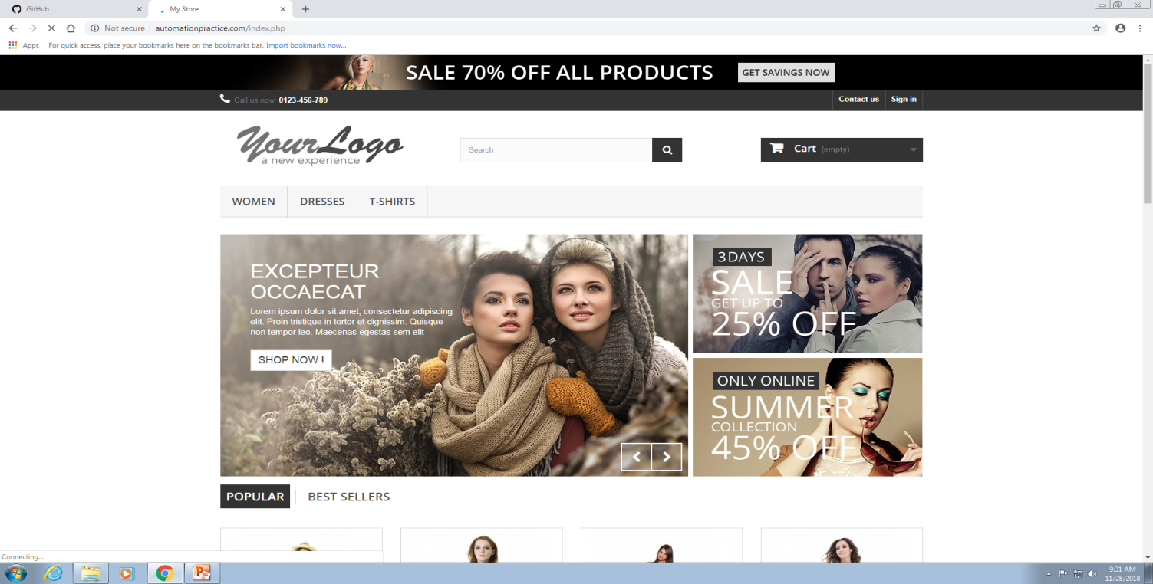
OVERVIEW OF THE PROJECT
This project is about an e-commerce clothing website.
Website allows user to view products and allows them to purchase it if interested.
It’s a shopping site which is designed for shopping of women clothing.
The Application link is: http://www.automationpractice.com

Slide 4
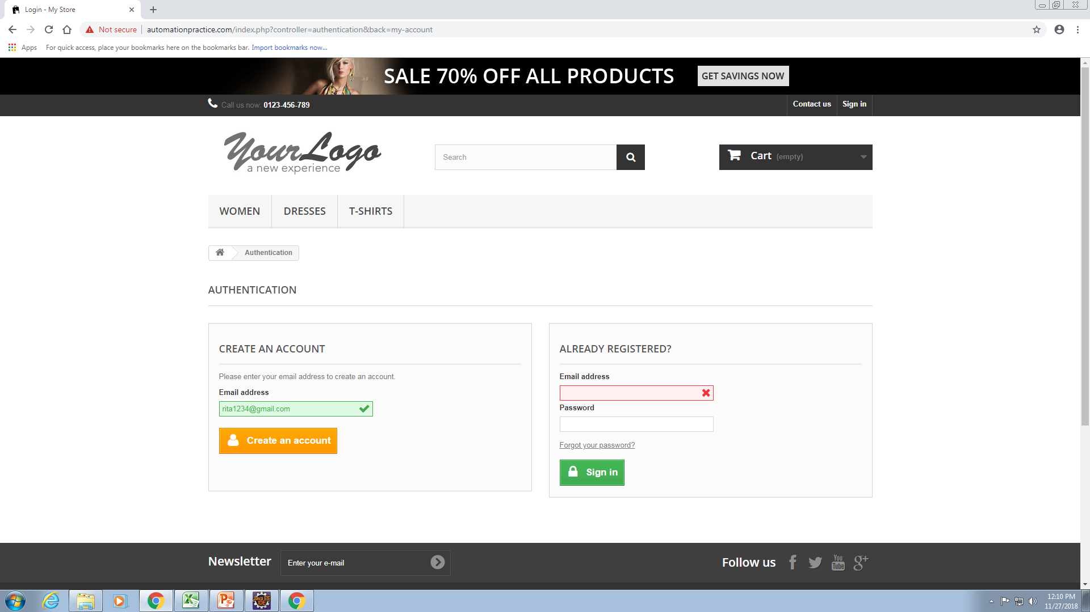
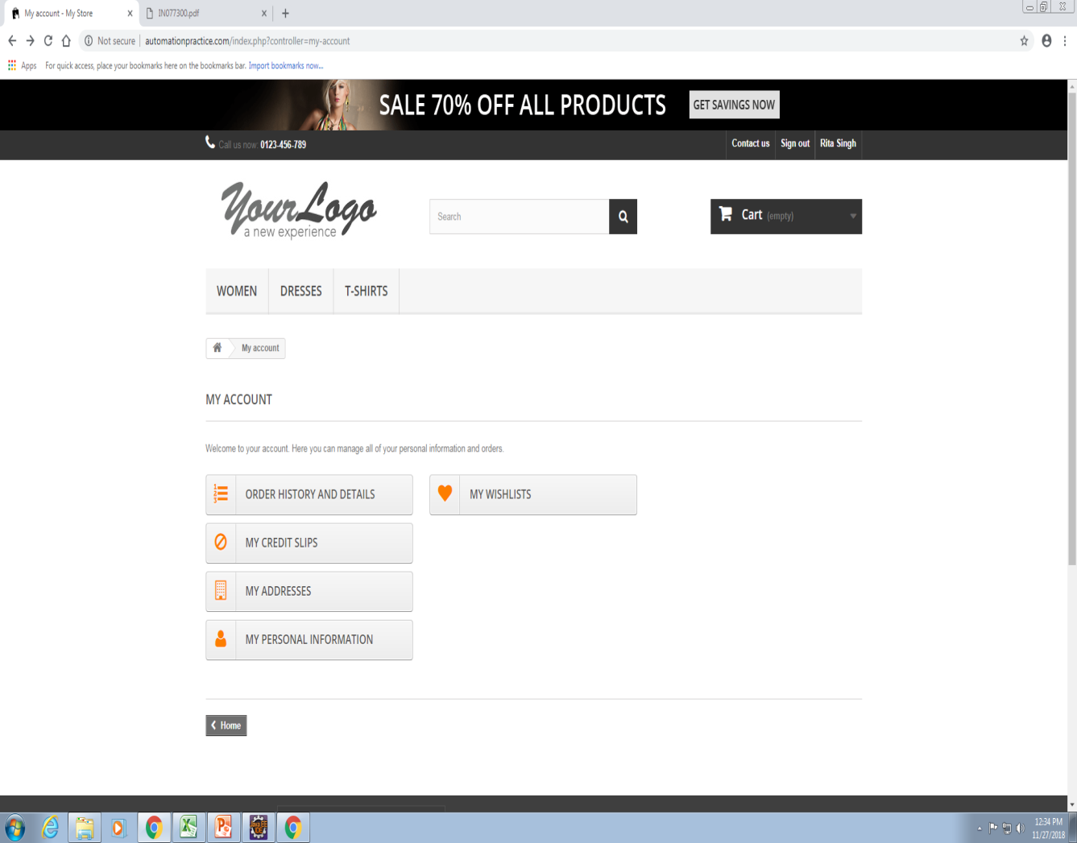
LOGIN PAGE
User Registers through email and fills the details
My Account page after login

Slide 5
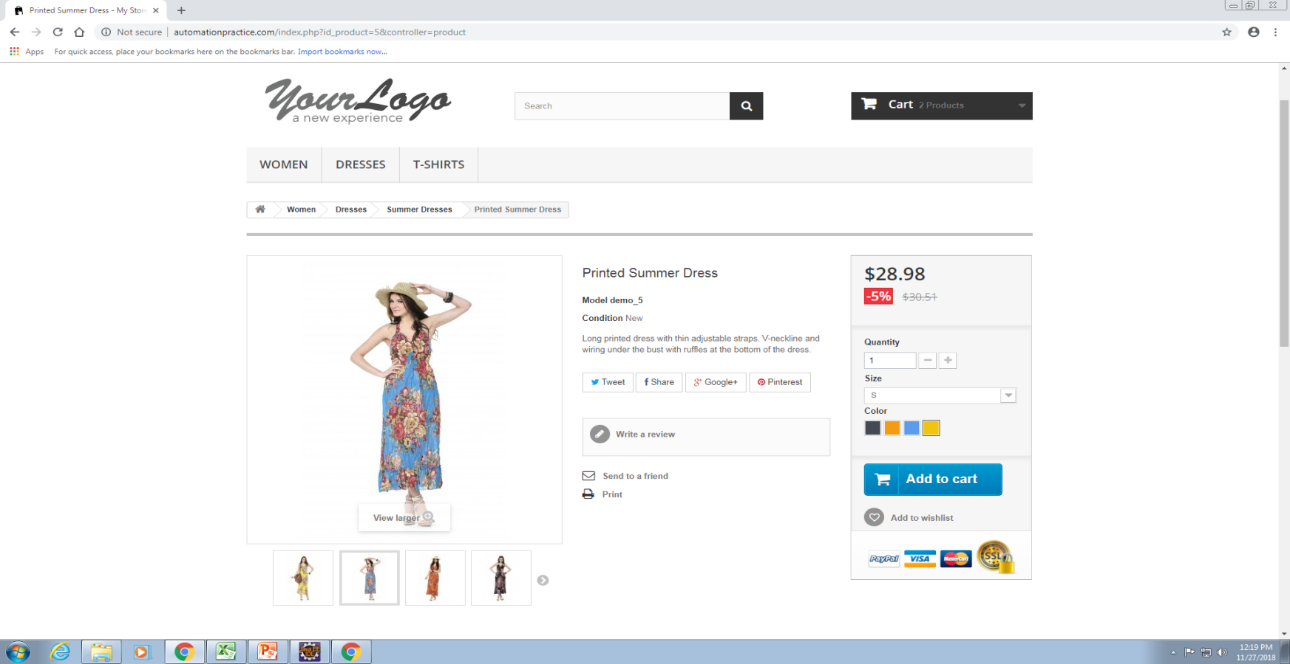
Product Description page
This page shows details of the product you have selected
Size and quantity can be selected here.
User can write a review for the product or can share it.
If user likes it , add to cart option is provided.

Slide 6
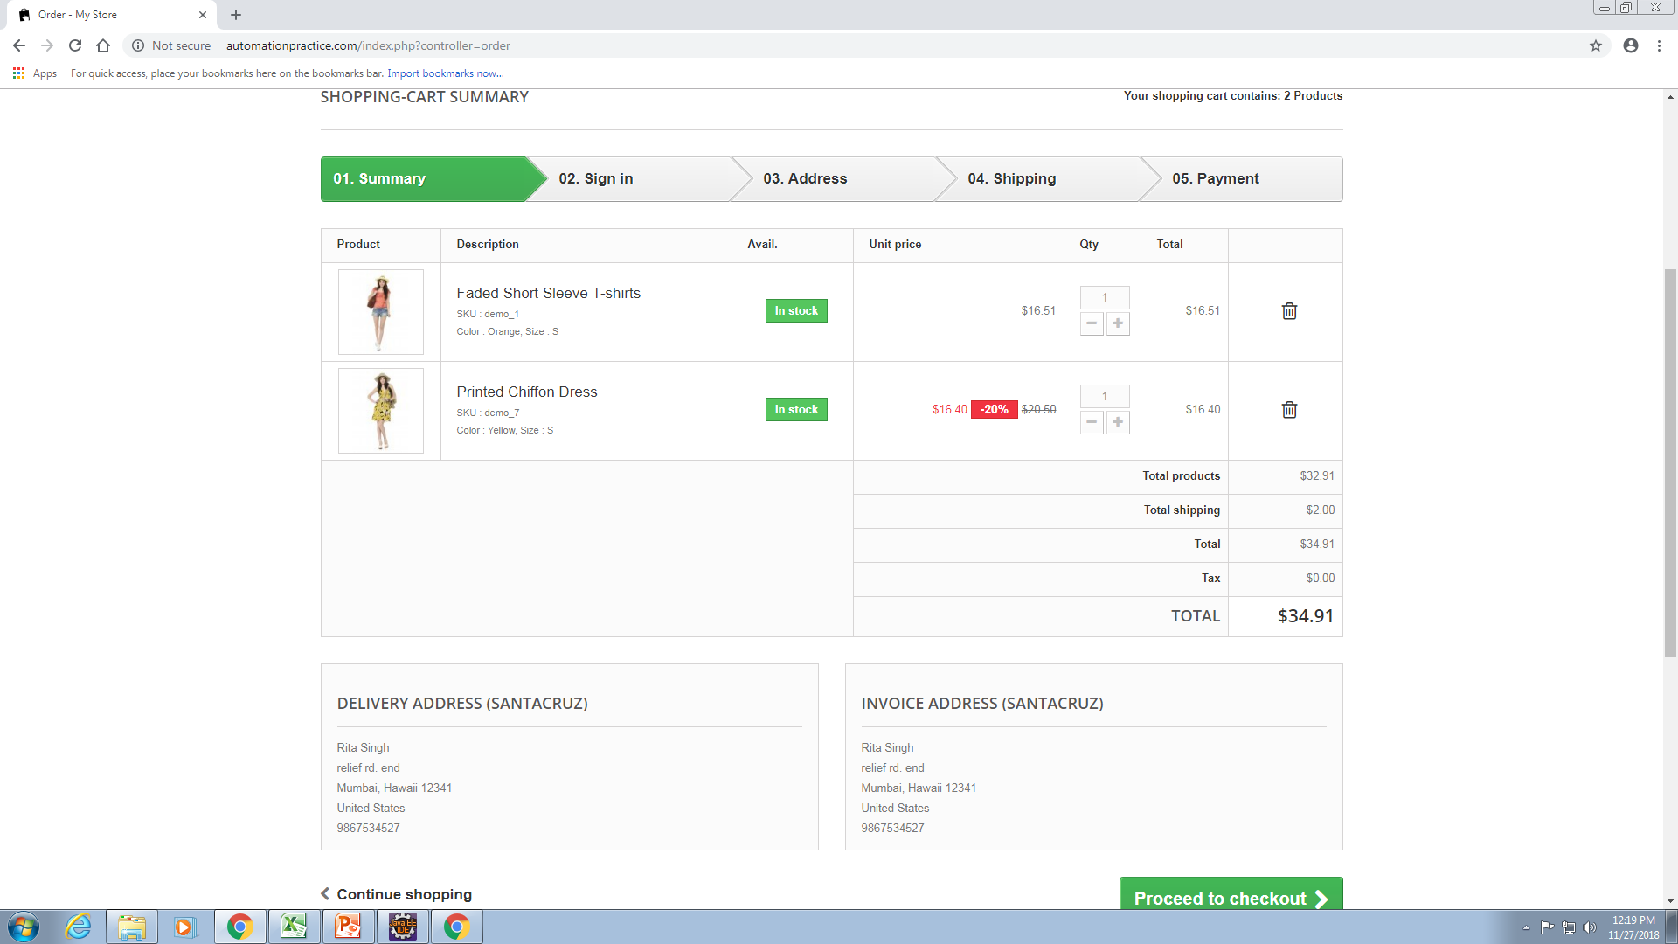
Shopping Cart Page
This page views the products in the cart.
User can Increase/Decrease the quantity of the product.
After this User can go ahead for payment.

Slide 7
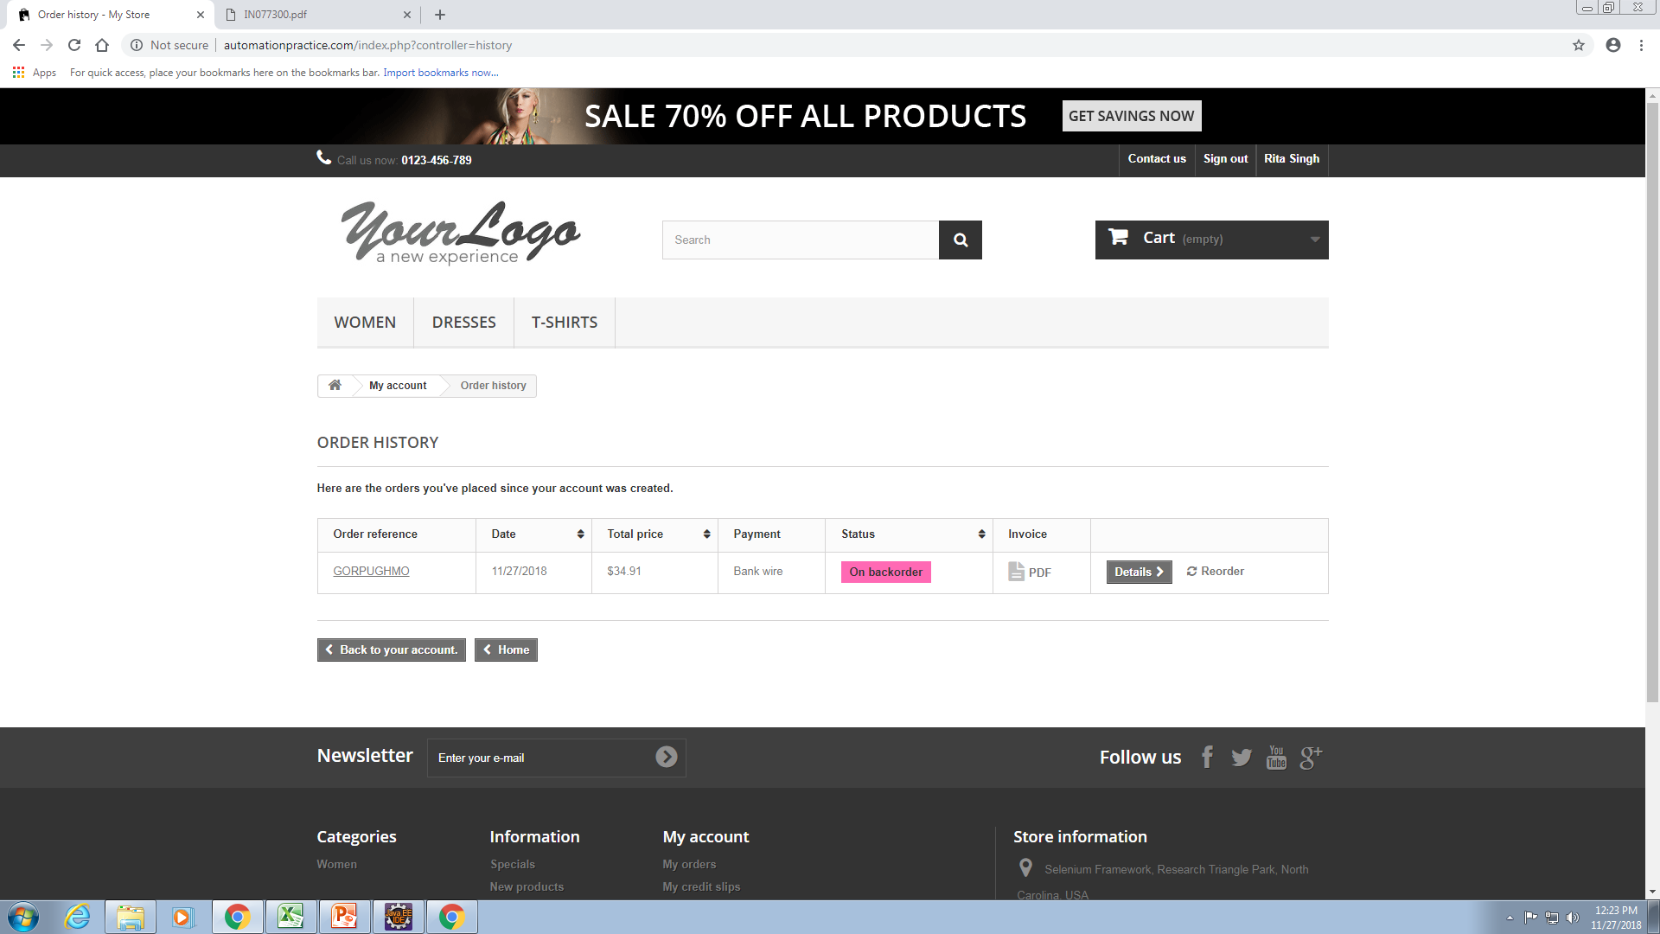
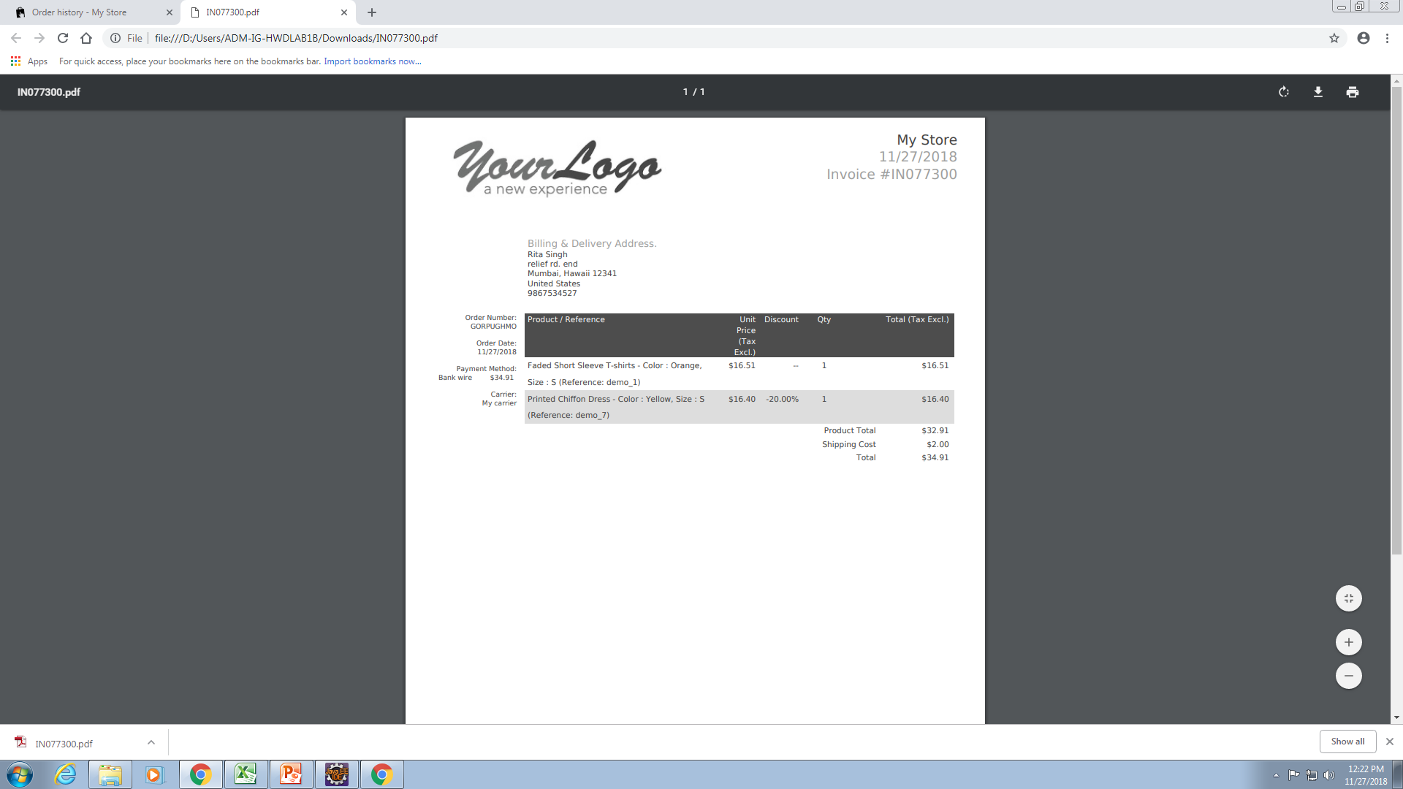
ORDER DETAILS PAGE
Page where user can download the bill
Details also can be viewed here
Bill is generated in PDF format

Slide 8
USE CASE
Login
Validate Customer
<<include>>
Order Product
Check Availability
<<extend>>
Cancel Order
Add Product To Wishlist
Payment Gateway
Customer
Payment For Product
Validate Customer Account Detail
<<include>>
Add Product
Product Shipping Details
Modify Details
<<extend>>
Admin
Remove product
Track order
Shipping Agents

Slide 9
REQUIREMENT TRACEABILITY MATRIX

Slide 10
TEST CASES
Test Cases are divided into:
Use case :
Intersystem :
Security :
State Transition :
Functional :
Cause and effect :
This is the link for viewing test cases :

Slide 11
Defects Found:
This is the link for viewing the defect report:

Slide 12
CONCLUSION
Found moderate number of defects in coding which can re-solved in minimal time span.
39 test cases were made
18 defects are found
The website could be more better if multiple payment options like pay by debit card , credit card, cash on delivery, etc. were provided.

Slide 13
Thank You

